Slide 1
Machine Learning – Overview

Slide 2

Main Areas of Artificial Intelligence
computer vision
(spatial structures, state-of-the-art: Convolutional Neural Networks)
natural language processing
(sequential structures, state-of-the-art: transformers)
automated decision making, robotics
(reinforcement learning)
All of these are enabled by one key ingredient:
learning from experience (Machine Learning)
also: knowledge representation, automated reasoning (first indices in modern large language models)
from wikipedia
agency:
perception – thought – action
from Artificial Intelligence: A Modern Approach (Russell, Norvig)

Slide 3
Buzz Words …
Artificial Intelligence
Deep Learning:
special kind of ML algorithms using (deep) neural networks
Data Science:
extract knowledge from data (by means of ML, among other things)
Machine Learning
Deep
Learning
Data Science

Slide 4

Traditional Algorithms and GOFAI
traditional algorithms:
explicit (handcrafted) instructions for each situation
symbolic AI (aka GOFAI):
use knowledge by means of symbols (as representations), logic, search (e.g., expert systems like Deep Blue)
Public perception is changing over time: A modern chess program, nowadays disparaged as brute computing, would have been considered intelligent in the 50s.
from wikipedia

Slide 5
ML: Learning from Experience/Data
mainly exploiting statistical dependencies with the aim of generalization to new (e.g., future) data (compare with human reasoning by analogies)
training (usually offline optimization):
ML algorithm + data = explicit algorithm (to be used at inference time)
reduction of complexity and much better generalizability compared to handcrafted algorithms
analogy: Humans do not hit the ground running (storage capacity of DNA limited) but have learning capabilities.

Slide 6
Supercharging the Scientific Method
use ML and data to replace or enhance explicit methods relying on detailed domain knowledge (Software 2.0)
overcome our evolutionary limitations in math with clever learning algorithms and collecting data
immediate impact on many aspects of industry, business, and science, formulated as narrow tasks with strictly defined inputs (aka weak AI)
more imminent than (still philosophical) long-term quest for human-level AI (aka strong AI, AGI), i.e., general-purpose intelligence
(although recent language models show multi-purpose capabilities)

Slide 7
When to apply ML?
complexity
decisions under uncertainty, many influencing factors
e.g., demand forecasting, DNA sequencing
difficult for humans, direct model inexpressible
automation
e.g., face and speech recognition, autonomous driving
goal to reach human-level performance
… and of course you need data to learn from
and more recently:
generative tasks
rather than predictive (or discriminative) ones
e.g., image generation, conversational AI, new proteins or materials

Slide 8
Learning Paradigms

Slide 9

Supervised Learning
learning by teacher → usually rather narrow tasks (passive approach)
Target Quantity
Features
known in training: labeled samples or observations from past
to be predicted for unknown cases (e.g., future values)
input information that is
correlated to target quantity
known at prediction time
Example: Spam Filtering
Classify emails as spam or no spam
use information like occurrence of specific words or email length as features
features x1 and x2 spam, no spam
use accordingly labeled emails as training set

Slide 10
Reinforcement Learning
learning by trial-and-error (exploration and exploitation)
goal-based approach → active and more generic than supervised learning (but sparse reward signals)
receiving feedback from the environment, no supervision
formalization of sequential decision making (delayed rewards)
corresponds to search for best action policy to reach a given goal (e.g., win a game)
using learning from examples (data) to guide the search
RL setup usually more difficult (e.g., non-differentiable as a whole) than supervised learning one (which can be seen as “generalized optimization”, often of proxy metric)
but RL can be cast as supervised-learning setup: express rewards by more intricate loss function

Slide 11

Reduction of Search Space
one-step TD
reduce depth of search by bootstrapping with value function predicting future outcome
n-step TD
MC
from Sutton
reduce breadth of search by sampling actions from policy

Slide 12



Main Concepts of Value-Based RL Methods
bootstrapping: update estimates of state values based on estimates of values of successor states
sampling: experience of sample sequences (no need for complete knowledge of environment)
Dynamic Programming
Temporal Difference (TD) Learning
Monte Carlo (MC)
from Sutton
bootstrapping
no sampling → model-based (transition probabilities needed)
bootstrapping
sampling → model-free
no bootstrapping
sampling → model-free

Slide 13


Unsupervised Learning
ML needs lots of training data
learning by observation
no target information → kind of “vague” pattern recognition (but plenty of data)
can be cast as supervised-learning setup: self-supervised learning
input-output mapping like supervised learning
but generating labels itself from input information
learning of semantic feature representations
e.g., word2vec, BERT, GPT

Slide 14




MACHINE LEARNING
no supervision, but goal-based interaction with environment
training target available (labeled or past data)
data not labeled in any way
REINFORCEMENT LEARNING
SUPERVISED
UNSUPERVISED
CLASSIFICATION
ASSOCIATION
CLUSTERING
LEARN STATE OR ACTION VALUES
LEARN POLICY DIRECTLY
REGRESSION
DIMENSIONALITY REDUCTION
learning by teacher
(high-dimensional curve fitting)
learning by observation
(pattern recognition)
learning by trial-and-error
(sequential decision making)
unsupervised and reinforcement learning can both be cast as supervised-learning setup

Slide 15
Fitting and Generalization

Slide 16


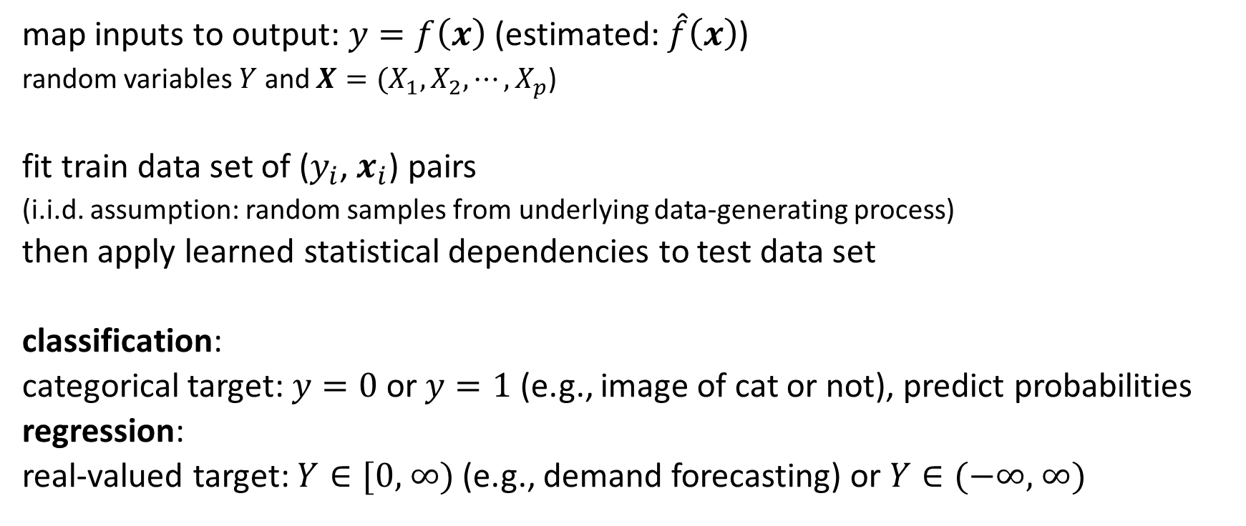
Supervised Learning Scenario
… ML …
ML domain:
no deterministic dependencies between input and output
map inputs to output: $y=f\left(x\right)$ (estimated: $\hat{f}\left(x\right)$)
random variables $Y$ and $X={(X}_{1}, X_{2},{⋯,X}_{p}$)
fit train data set of ($y_{i}$, $x_{i}$) pairs
(i.i.d. assumption: random samples from underlying data-generating process)
then apply learned statistical dependencies to test data set
classification:
categorical target: $y=0$or $y=1$ (e.g., image of cat or not), predict probabilities
regression:
real-valued target: $Y∈\text{[0, ∞)}$ (e.g., demand forecasting) or $Y∈\text{(−∞, ∞)}$
usually many dimensions

Slide 17
Generalization
generalization as core of ML:
empirical risk minimization (training error) as proxy for minimizing unknown population risk (test error, aka generalization error or out-of-sample error)
generalization gap: difference between test and training error
interpolation to unencountered samples from training environment
extrapolation to testing conditions differing from training environment
curse of dimensionality: many features (dimensions) → lots of data needed to densely sample volume
but reality is friendly: most high-dimensional data sets reside on lower-dimensional manifolds (manifold hypothesis) → enabling effectiveness of ML
need for appropriate inductive bias (aka learning bias): set of assumptions of a learning algorithm to predict outputs of inputs not encountered during training (“data in disguise”)
inductive bias comes in many different forms: model design (e.g., linear response), regularization (e.g., convolutions), optimization algorithms, …

Slide 18


Bias, Variance, Irreducible Error
think of fitting ML algorithms as repeatable processes with different (i.i.d.) data sets
irreducible error (aka Bayes error):
inherent randomness (target generated from random variable following probability distribution)
limiting accuracy of ideal model
different potential reasons for inherent randomness (noise): complexity, missing information, …
bias:
due to too simplistic model (same for all training data sets)
“underfitting”
variance:
due to sensitivity to specifics (noise) of different training data sets
“overfitting”

Slide 19

Bias-Variance Tradeoff
fundamental concept in classical statistical learning theory
models of higher complexity have lower bias but higher variance (given the same number of training examples)
generalization error follows U-shaped curve: overfitting once model complexity (number of parameters) passes certain threshold
overfitting: variance term dominating test error
→ increasing model complexity increases test error
from wikipedia

Slide 20

Example: Non-Linear Function Approximation
degree of fitted polynomial
from scikit-learn documentation

Slide 21
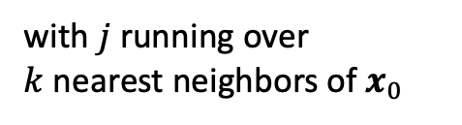

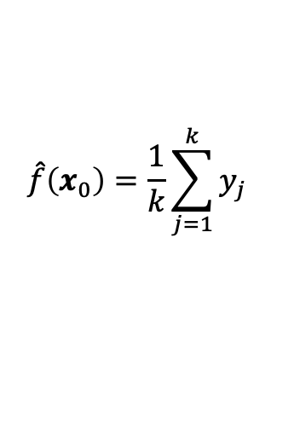
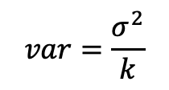
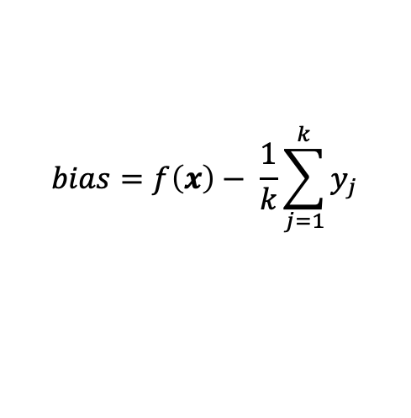
Example: k-Nearest Neighbors
local method, instance-based learning
non-parametric
distance defined by metric on $x$ (e.g., Euclidean)
regression:
$$\hat{f}\left(x_{0}\right)=\frac{1}{k}\sum_{j=1}^{k}{y_{j}}$$
with $j$ running over $k$nearest neighbors of $x_{0}$
low k: low bias but high variance
high k: low variance but high bias
$$bias=f\left(x\right)− \frac{1}{k}\sum_{j=1}^{k}{y_{j}}$$
$$var=\frac{σ^{2}}{k}$$

Slide 22


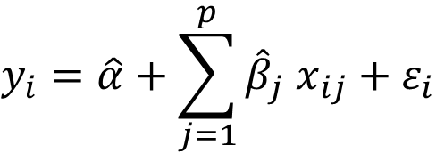
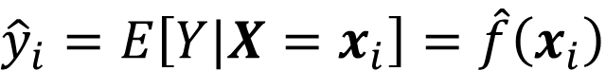


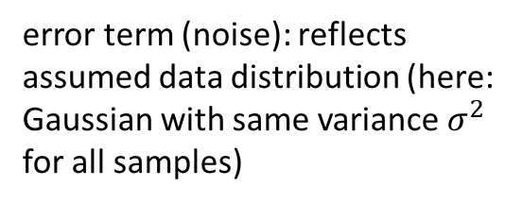
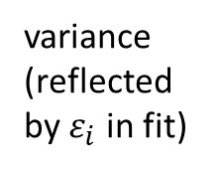
Linear Regression
error term (noise): reflects assumed data distribution (here: Gaussian with same variance $σ^{2}$ for all samples)
$$\hat{f}\left(x_{i}\right)$$
from wikipedia
fit:
parameters to be estimated:
$\hat{α},\hat{β}$
${\hat{σ}}^{2}=$ $\frac{1}{n}\sum_{i=1}^{n}{{\left(y_{i}−\hat{f}\left(x_{i}\right)\right)}^{2}}$
(approximating assumed true $α, β$, $σ$)
$$y_{i}=\hat{α}+\sum_{j=1}^{p}{{\hat{β}}_{j} x_{ij}}+ε_{i}$$
(model)
predict:
$$p\left(y|x_{i}\right)=𝒩\left(y;{\hat{y}}_{i}, {\hat{σ}}^{2}\right)$$
$${\hat{y}}_{i}=E\left[Y|X=x_{i}\right]=\hat{f}\left(x_{i}\right)$$
Gaussian
mean
variance
(reflected by $ε_{i}$ in fit)
conditional mean for squared loss of least squares method
predict arbitrary quantile by means of quantile loss

Slide 23
General Recipe of Statistical Learning
statistical learning algorithm by combining:
model (e.g., linear function, Gaussian distribution)
objective function (e.g., squared residuals)
optimization algorithm (e.g., gradient descent)
regularization (e.g., convolutions)

Slide 24
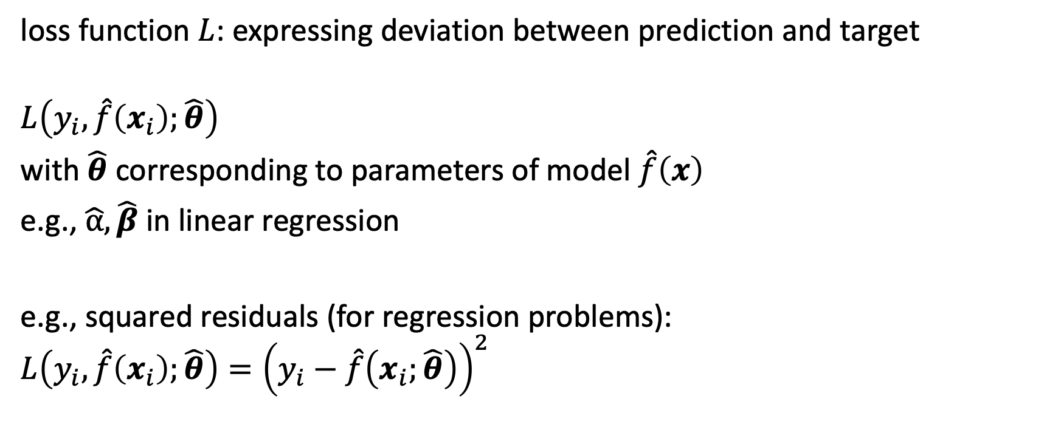
Loss Function
loss function $L$: expressing deviation between prediction and target
$$L\left(y_{i},\hat{f}\left(x_{i}\right);\hat{θ}\right)$$
with $\hat{θ}$ corresponding to parameters of model $\hat{f}\left(x\right)$
e.g., $\hat{α}, \hat{β}$ in linear regression
e.g., squared residuals (for regression problems):
$$L\left(y_{i},\hat{f}\left(x_{i}\right);\hat{θ}\right)={\left(y_{i}−\hat{f}\left(x_{i};\hat{θ}\right)\right)}^{2}$$

Slide 25
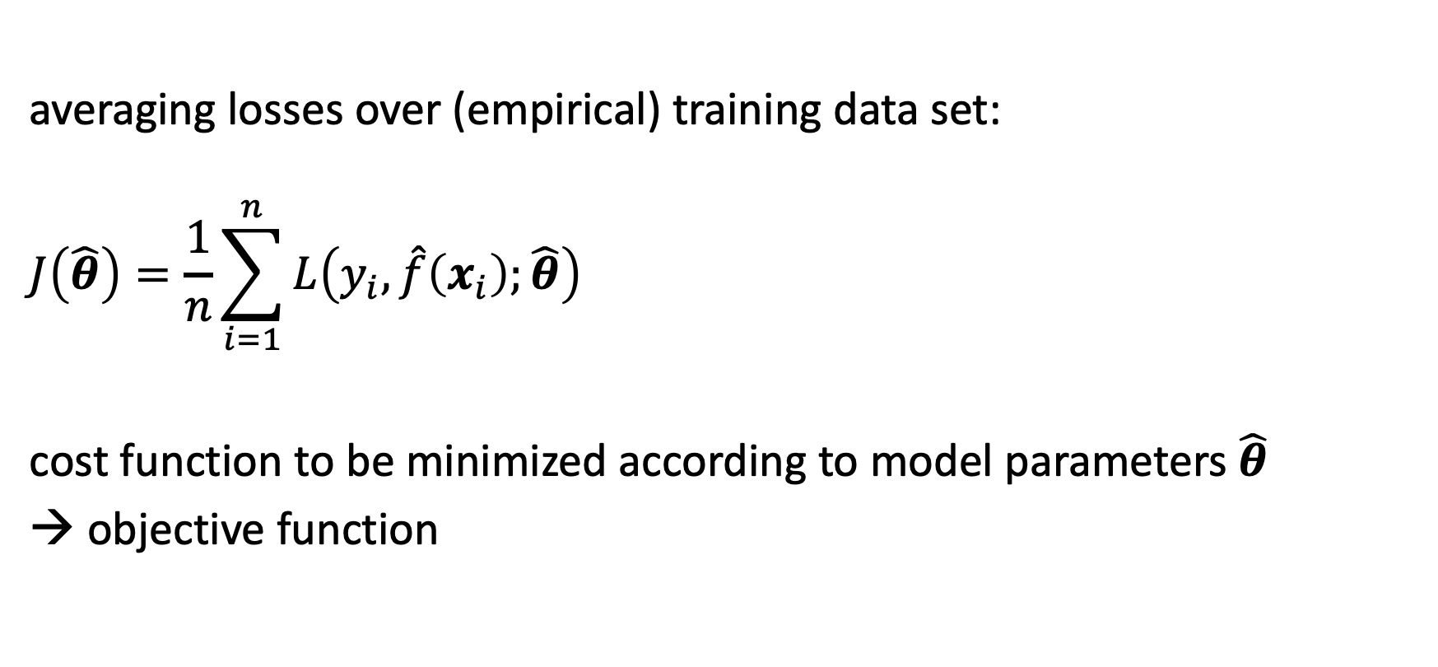
Cost Function
averaging losses over (empirical) training data set:
$$J\left(\hat{θ}\right)=\frac{1}{n}\sum_{i=1}^{n}{L\left(y_{i},\hat{f}\left(x_{i}\right);\hat{θ}\right)}$$
cost function to be minimized according to model parameters $\hat{θ}$
→ objective function

Slide 26

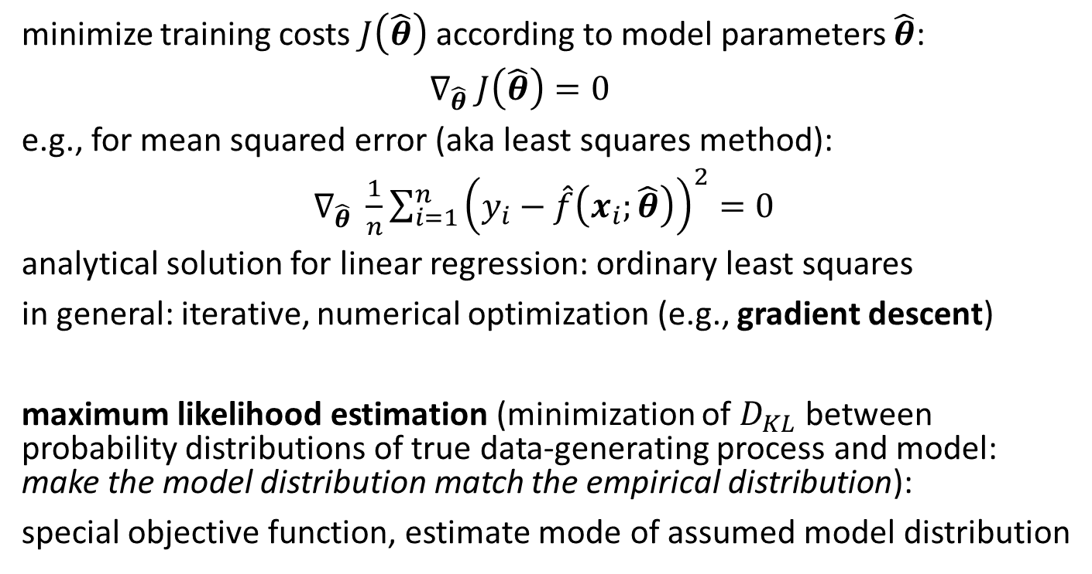
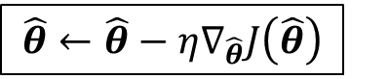
Cost Minimization
global minimum
local minimum
minimize training costs $J\left(\hat{θ}\right)$ according to model parameters $\hat{θ}$:
$∇_{\hat{θ}} J\left(\hat{θ}\right)=0$
e.g., for mean squared error (aka least squares method):
$∇_{\hat{θ}} \frac{1}{n}\sum_{i=1}^{n}{{\left(y_{i}−\hat{f}\left(x_{i};\hat{θ}\right)\right)}^{2}}=0$
analytical solution for linear regression: ordinary least squares
in general: iterative, numerical optimization (e.g., gradient descent)
maximum likelihood estimation (minimization of $D_{KL}$ between probability distributions of true data-generating process and model: make the model distribution match the empirical distribution):
special objective function, estimate mode of assumed model distribution
vector containing all partial derivatives
$$\hat{θ}←\hat{θ}−η∇_{\hat{θ}}J\left(\hat{θ}\right)$$
step size (learning rate)

Slide 27

Algorithmic Families
linear (parametric) models
nearest neighbors (local methods, instance-based learning) – non-parametric models
decision trees
linear regression
Generalized Linear Models
Generalized Additive Models
Day
Weekday
Weekend
3
neural networks: non-linear just by means of activation functions
Promo
No
Yes
demand prediction
5
8
often used in ensemble methods
bagging: random forests
boosting: gradient boosting
kernel/support-vector machines: linear model (maximum-margin hyperplane) with kernel trick
from wikipedia

Slide 28
Most ML algorithms (even unsupervised and RL) can be described by the general recipe of combining models, costs, optimization, and regularization methods.
including non-linear models like neural networks (backpropagation), support-vector machines (hinge loss in soft-margin SVM), or decision trees (impurity functions)
Most powerful ML algorithms are compound, with rather simple (often linear) building blocks. → reductionism with complex interactions
To generalize well, one needs to find a method with an appropriate inductive bias for the task at hand (e.g., suitable objective function or regularization method like convolutional layers).

Slide 29
Deep Learning

Slide 30


Recap: Goal of ML
generalization from optimization on training data set (approximation of true data generating probability distribution by empirical risk minimization)
fitting: complex function approximation
for generalization: learning of good abstraction/representation of data/concepts
→ deep learning methods (neural networks with many layers) optimal candidates
e.g., convolutional neural networks (CNN) can learn hierarchical representation by means of many convolutional and pooling layers
receptive fields:
the deeper the better:
accuracy, hierarchical representation (many aspects of nature hierarchical)
source
source

Slide 31

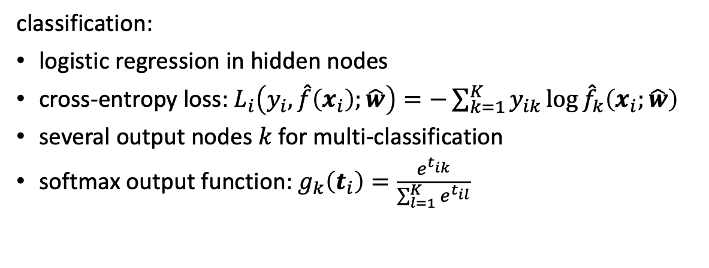
Multi-Layer Perceptron (MLP)
fully-connected feed-forward network with at least one hidden layer
toward deep learning: add hidden layers
more layers (depth) more efficient than just more nodes (width): less parameters needed for same function complexity
classification:
logistic regression in hidden nodes
cross-entropy loss: $L_{i}\left(y_{i},\hat{f}\left(x_{i}\right);\hat{w}\right)=−\sum_{k=1}^{K}{y_{ik}\log{{\hat{f}}_{k}\left(x_{i};\hat{w}\right)}}$
several output nodes $k$ for multi-classification
softmax output function: $g_{k}\left(t_{i}\right)=\frac{e^{t_{ik}}}{\sum_{l=1}^{K}{e^{t_{il}}}}$
regression:
squared error loss
identity output function
usually just one output node

Slide 32

Learning Mechanism: Back-Propagation
back-propagation of errors (gradients of cost function according to weights) through layers via chain rule of calculus (avoiding redundant calculations of intermediate terms)
each node exchanges information only with directly connected nodes → enables efficient, parallel computation
forward pass: current weights fixed, predictions computed
backward pass: errors computed from predictions and back-propagated → weights then updated according to loss gradients (via gradient descent)
source

Slide 33



Convolutional Neural Networks
CNN in short: local connections, shared weights, pooling, many layers
translation invariance
local patches
convolution:
parameter sharing
kernel (learned parameters)
convolutional vs
fully-connected layer:
source
input
source
max pooling:
many images (training examples), potentially with several channels
down-sampling by convolutions and pooling
several kernels producing several feature maps
flatten dimensions for final classification or regression
from wikipedia
highly regularized form of feed-forward neural networks

Slide 34



Rise of Deep Learning
a little bit oversimplified:
deep learning = lots of training data + parallel computation + smart algorithms
AlexNet:
ImageNet (with data augmentation) + GPUs (allowing more layers) + ReLU, dropout
(pivotal moment for deep learning: ImageNet challenge 2012)
from wikipedia
source

Slide 35

Training Subtleties of Deep Neural Networks
optimization and regularization difficult
non-convex optimization problem (e.g., local vs global minima, saddle points), easily overfitting
many hyperparameters to tune
many methods to get it working in practice (despite partly patchy theoretical understanding)
typical loss surface:
source
optimization
activation and loss functions
weight initialization
stochastic gradient descent
adaptive learning rate
batch normalization
explicit regularization
weight decay
dropout
data augmentation
weight sharing
implicit regularization
early stopping
batch normalization
stochastic gradient descent

Slide 36
Large Language Models (LLM)
natural language processing: dealing with sequential structures (e.g., text)
examples:
machine translation (sequence-to-sequence model)
sentiment classification
chat bot (conversational AI)
context awareness via embeddings and (formerly) recurrent neural networks (RNN) or (nowadays) self-attention
LLMs: transformer models with hundreds of billions of parameters

Slide 37




Embeddings
representation of entities by vectors
similarity between embeddings by, e.g., cosine similarity → semantic similarity
most famous application: word embeddings → associations (natural language processing)
but general concept: embeddings of (categorical) features (e.g., products in recommendation engines)
learned via co-occurrence (e.g., word2vec)
but also direction of difference vectors interesting (analogies):
source

Slide 38

Transformer
attention is all you need: getting rid of RNNs
replaced by multi-headed self-attention (implemented with matrix multiplications and feed-forward neural networks)
allowing for much more parallelization
→ allowing for bigger models (more parameters)
better long-range dependencies thanks to shorter path lengths in network (less sequential operations)
source

Slide 39


Self-Attention
evaluating other input words in terms of relevance for encoding of given word
multi-head attention: several attention layers running in parallel (considering different aspects of input)
source

Slide 40


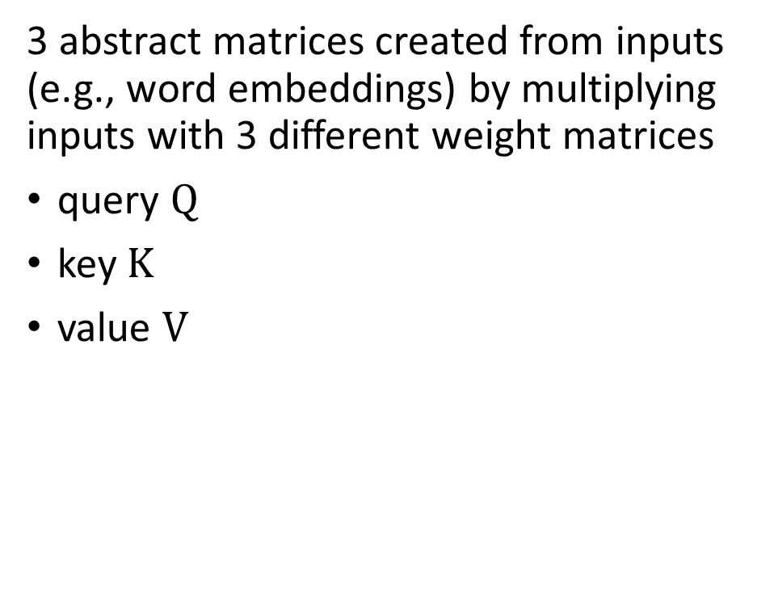
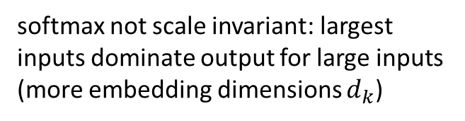
Scaled Dot-Product Attention
softmax not scale invariant: largest inputs dominate output for large inputs (more embedding dimensions $d_{k}$)
3 abstract matrices created from inputs (e.g., word embeddings) by multiplying inputs with 3 different weight matrices
query $Q$
key $K$
value $V$
filtering: multiplication of attention probabilities with corresponding key word values
scoring each of the key words (context) with respect to current query word
key-value pairs
query
source

Slide 41

Sequence Completion
greedily picking the one with highest probability
pick according to probabilities (degree of randomness controlled by softmax temperature)
beam search
for each step/token (iteratively), choose one output token to add to decoder input sequence → increasing uncertainty
prompt: externally given initial sequence for running start and context on which to build rest of sequence (prompt engineering)
auto-regressive
source
source

Slide 42

Typical Transformer Architectures for LLMs
encoder-decoder LLMs: sequence-to-sequence, e.g., machine translation
encoder-only LLMs:
representation learning (and subsequent fine-tuning)
training: prediction of masked words
incorporate context of both sides of token
decoder-only LLMs:
text generation (potentially in-context only), e.g., chat bot
training: next-word prediction
output one token at a time (auto-regressive)
example: Google’s BERT (Bidirectional Encoder Representations from Transformers)
example: OpenAI’s GPT (Generative Pre-trained Transformer)
GPT-4 capabilities
source

Slide 43
Multi-Task Learning of LLMs
compositional nature of deep learning allows transfer learning in a semi-supervised way (also prominent for CNNs in computer vision):
self-supervised pre-training (e.g., next-word prediction) on massive data sets (foundation models like GPT or BERT)
subsequent supervised fine-tuning on specific tasks and (usually much smaller) data sets (by adapting parameters or/and adding layers )
in-context learning as alternative to fine-tuning: only using information fed into LLM via input prompt, no parameter updates (typically decoder-only)
typical prompt: instructions, context (potentially retrieved externally from, e.g., knowledge-base embeddings), query, output indicator
query with (few-shot) or without (zero-shot) providing explicit examples
prompt engineering

Slide 44

Conversational AI: RL from Human Feedback
example for supporting large language models (transformers) with RL
used in famous ChatGPT
goal: improve alignment with user intentions
→ learn from human preferences
RL looks at reward of text output passages as a whole
(rather than token-level loss in supervised learning)
source

Slide 45

Transformer for Vision
formulation as sequential problem:
split image into patches and flatten → use as tokens
produce linear embeddings and add positional embeddings
processing by transformer encoder:
pre-train with image labels
fine-tune on specific data set
source

Slide 46

Combination of Vision and Text: Multi-Modality
example: CLIP (Contrastive Language-Image Pre-training)
learn image representations by predicting which caption goes with which image (pre-training)
zero-shot transfer (e.g., for object recognition)
multi-modal perception as input for large language models: KOSMOS-1
multi-purpose (multi-modal and multi-task) models as next generalization step of ML (e.g., Google’s Pathways)
transformers good candidate (universal and flexible architecture, little task-specific inductive bias)

Slide 47
Generative Models

Slide 48

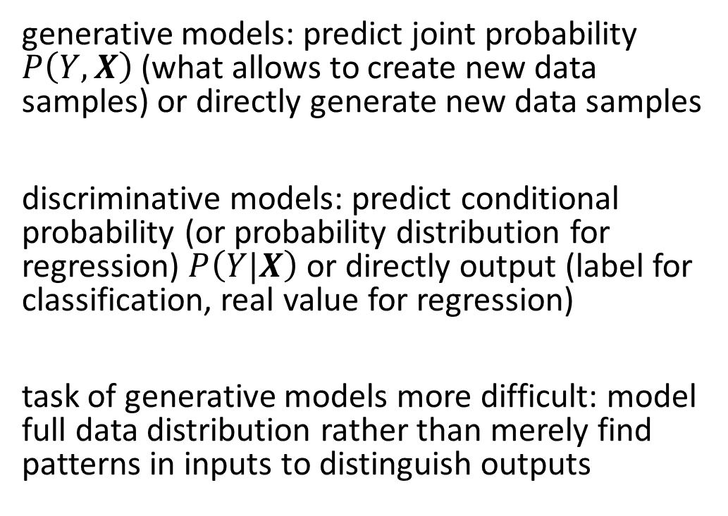
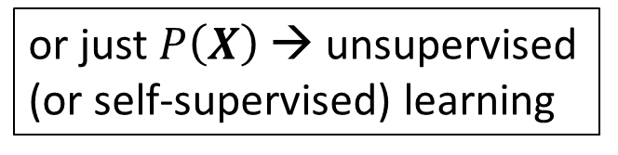
Generative vs Discriminative Models
or just $P\left(X\right)$ → unsupervised (or self-supervised) learning
generative models: predict joint probability $P\left(Y,X\right)$ (what allows to create new data samples) or directly generate new data samples
discriminative models: predict conditional probability (or probability distribution for regression) $P\left(Y|X\right)$ or directly output (label for classification, real value for regression)
task of generative models more difficult: model full data distribution rather than merely find patterns in inputs to distinguish outputs
discriminative model
generative model
source

Slide 49
Data Generation
generative models can be used for discriminative tasks (although potentially inferior to direct discriminative methods)
but generative methods do more than discriminative ones: model full data distribution
→ allows generation of new data samples (can be images, text, video, audio, code like SQL or Python, proteins, materials, time series, structured data, …)
large (auto-regressive) language models examples of generative models

Slide 50

Different Types of Generative Models
two neural networks playing a zero-sum game
learn variational distribution (not just replicating inputs)
more complex distributions by applying change-of-variable technique (need for specialized architecture)
chain of denoising autoencoders
source

Slide 51


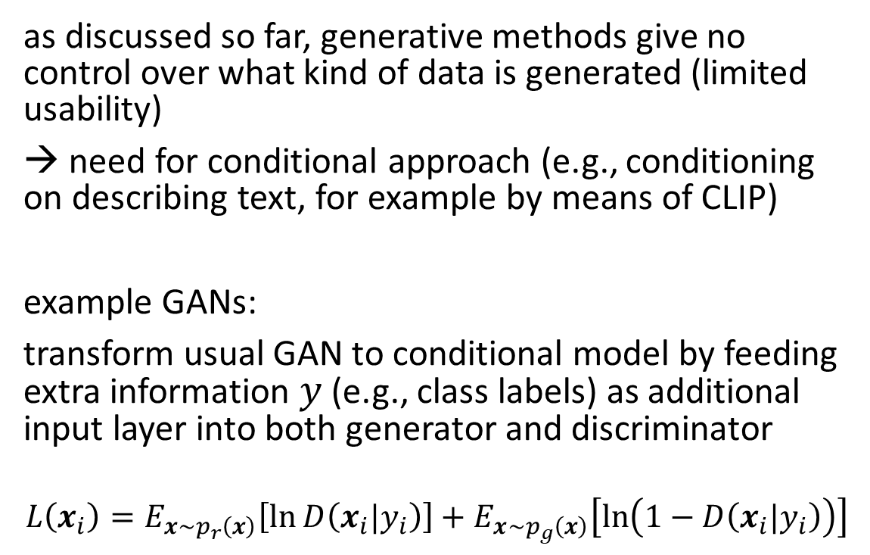
Conditioning
tradeoff between diversity (unconditioned) and fidelity (guidance)
similar idea as softmax temperature in auto-regressive LLMs
as discussed so far, generative methods give no control over what kind of data is generated (limited usability)
→ need for conditional approach (e.g., conditioning on describing text, for example by means of CLIP)
example GANs:
transform usual GAN to conditional model by feeding extra information $y$ (e.g., class labels) as additional input layer into both generator and discriminator
$$L\left(x_{i}\right)=E_{x\sim p_{r}\left(x\right)}\left[\ln{D\left(x_{i}|y_{i}\right)}\right]+E_{x\sim p_{g}\left(x\right)}\left[\ln\left(1−D\left(x_{i}|y_{i}\right)\right)\right]$$
source
guided diffusion: “Pembroke Welsh corgi”
G: minimize, D: maximize
source

Slide 52

Multi-Modal Generative Models
example: generate images from text descriptions
DALL-E (blend of WALL-E and Salvador Dalí): decoder-only transformer auto-regressively modeling text and image tokens as single data stream
DALL-E 2: image generation conditioned on CLIP image embedding
source

Slide 53





Literature
historical overview of deep learning:
foundations of ML:
a few seminal papers:
back-propagation: one of the founding moments of deep learning
CNN: neural networks work
AlexNet: deep learning takes over
transformer: SOTA
foundations of deep learning:
https://www.deeplearningbook.org/
overview of reinforcement learning:
gentle but geniune introduction to causality:
Hastie
Sutton

Slide 54
Some Philosophical Thoughts
computational theory of mind: mind from matter
just scaling up current methods (e.g., LLMs) enough to achieve general intelligence? or additional methods needed?
agency via goal-based approaches? (is reward enough?)
emergent capabilities of complex systems difficult to foresee: emotions or consciousness occurring as emergent capabilities?

